Slide 1
Fundamentals of Electrical Engineering
Fall 2021
Slideshow by: Lily Zimmermann

Slide 2
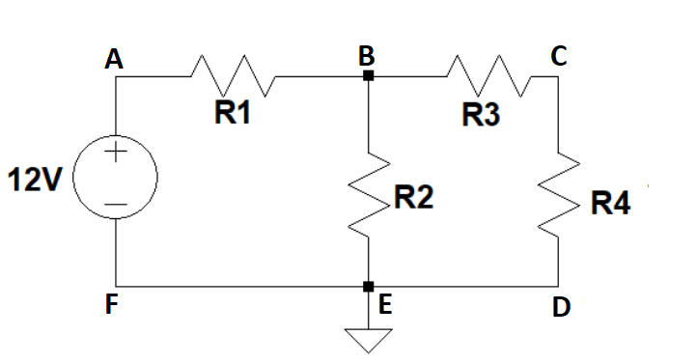
A Circuit

Slide 3
Circuit
Most of the circuit diagrams we will be covering will include the following:
1. A power source
2. Resistors
3. A Ground
4. Nodes

Slide 4
Circuit Elements
You will often see the words “circuit element” in descriptions in this course.
A circuit element is just any component of a circuit.
Types of circuit elements:
1. Voltage source
2. Current source
3. Resistor
4. Capacitor
5. Inductor

Slide 5
Elements of a Circuit Diagram

Slide 6
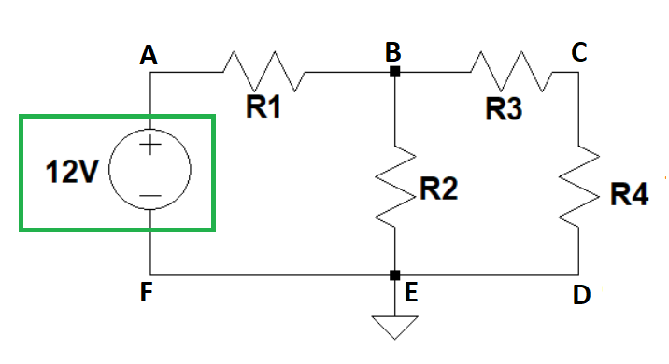
Elements of a Circuit Diagram: A Power Source
The circle on the left of the diagram is the power source
The “12V” next to the power source (often a battery) means it is generating 12 volts of power to the circuit

Slide 7
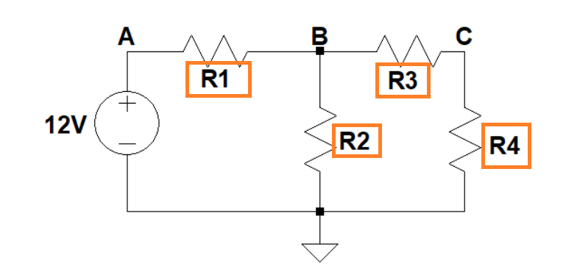
Elements of a Circuit Diagram: Resistors
Each zig-zag line with an R next to it represents a resistor
A resistor is meant to limit the flow of electric current
As voltage passes through a resistor, the voltage will lower

Slide 8
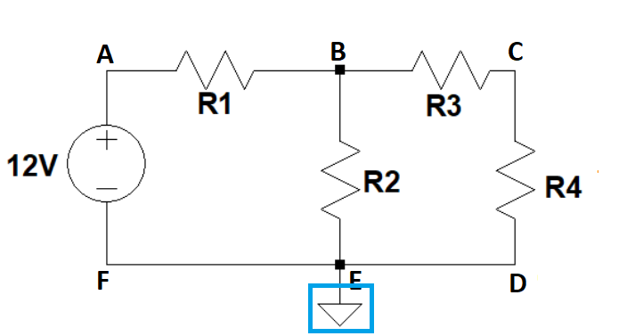
Elements of a Circuit Diagram: Ground
In this example, the arrow pointing down is the ground.
This is only meant to be a point of reference when making calculations through a circuit
Some students confuse this with the three prong electrical outlets that show that the electricity is grounded. They are not the same thing
Again: A ground on our diagrams is ONLY a point of reference on a circuit. It does not represent a physical thing.

Slide 9
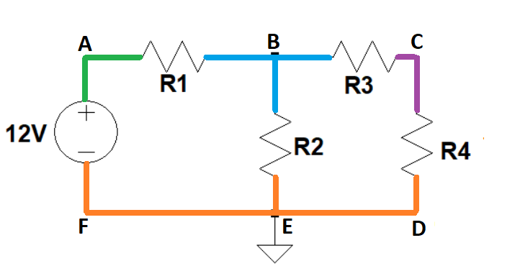
Elements of a Circuit Diagram: Nodes (part 1)
A node is any region on a circuit between two circuit elements (like between a resistor and another resistor or between the power source and a resistor)
Here each different color represents a different node
You will notice that F, E, and D are all touching the same node (the orange area). This means that F, E, and D are all part of the same node
For ease of explanation F, E, and D have been given different labels but please note that they are actually all part of the same node

Slide 10
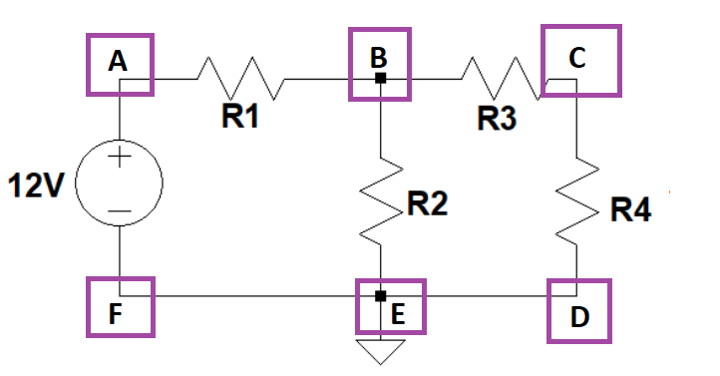
Elements of a Circuit Diagram: Nodes (part 2)
In the diagrams we will be using, we will reference the spots like A or C as nodes but please remember that a node is the full area between circuit elements
Again, F, E, and D will be referenced separately to make explaining easier, but please remember that they are all technically part of the same node.
The main time when these points will count as the same area versus separate points is when we discuss the locations were voltage changes in contrast to where current changes in a circuit, but that will be discussed much later

Slide 11
VOLTAGE, RESISTANCE, AND CURRENT

Slide 12
Voltage, Resistance and Current
We will be learning about certain laws in electrical engineering that involve voltage, resistance, and current.
Before learning about those laws, we will touch on what voltage, resistance, and current are.

Slide 13
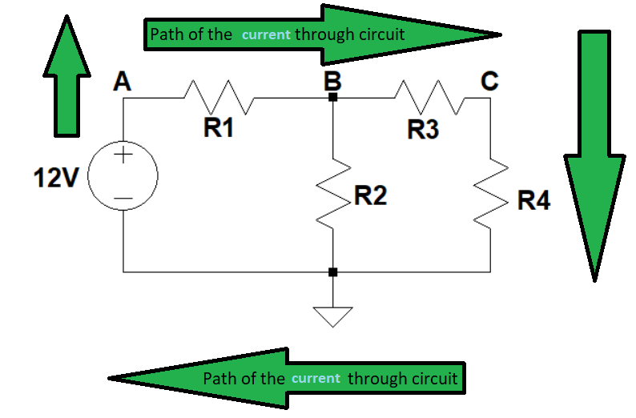
Resistance
SI unit for resistance: ohms
Symbol: Ω
Electrical resistance is the measure of a circuit element’s opposition to the flow of electric current. It is usually measuring how much something interrupts the flow of electrons.
Because of resistance, voltage will lower after passing through a circuit element like a resistor

Slide 14
Current
SI unit for current: amps
Symbol: I
Current is the rate of flow of electric charge or movement of charges.
It usually is measuring the flow of electrons through a circuit.
Current always goes from the positive end of the power source through the circuit until it reaches the negative end of the power source and goes through the loop again.
Normally the current would be electrons aimlessly moving around, but they are given a direction of flow from the push from voltage

Slide 15
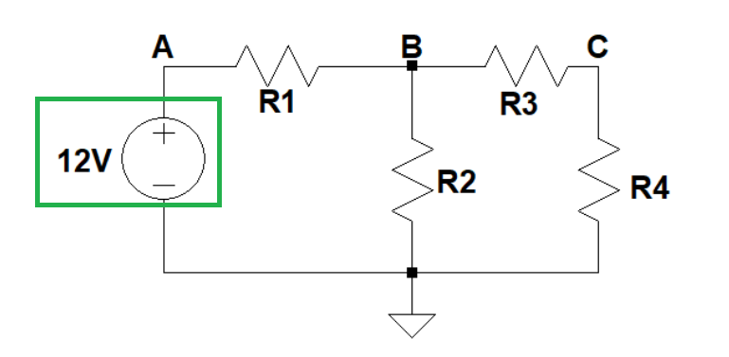
Voltage
SI unit for voltage: volts
Symbol: V
Voltage is a measure of how much pressure is applied to a current (or how much pressure is applied to charged electrons).
Voltage can also be described as the potential difference in electrical energy between two points in an electrical field or circuit.
NOTE:
Sometimes the number of volts on the diagram will show the voltage present at that location in the circuit
Other times, the number of volts will represent the difference between two locations, but that will be discussed later

Slide 16

Path of Voltage through a circuit
The voltage from a power source will always go from the positive end of the power source to the negative end of the power source
When we talk about the path however, we want to refer to the current

Slide 17
Two Uses of the Word Voltage on a Circuit Diagram

Slide 18
Two Uses of the Word Voltage on a Circuit Diagram
1. The voltage present
2. The change in voltage or difference of voltage between two points

Slide 19
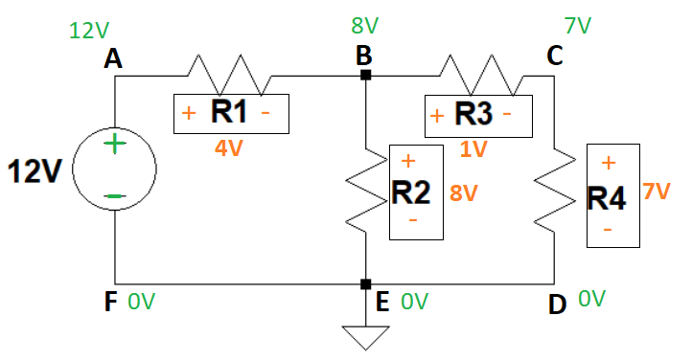
Different Labels for Voltage (part 1)
In this example, the green voltage represents the voltage at certain locations in the circuit
The orange voltage shows the difference in voltage that occurs when passing through each resistor

Slide 20
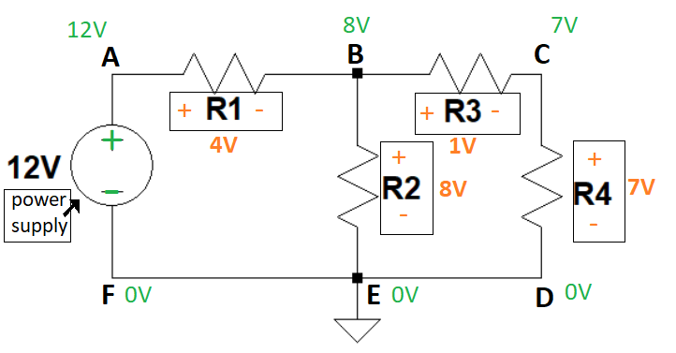
Different Directions of plus (+) and minus (-)
Notice that the power supply and resistors have positive & negative signs in the opposite direction.
(+/-) of the power supply corresponds with the green voltage
(+/-) of resistors corresponds with the orange voltage
QUESTION
Since we know that the orange voltage represents the change in voltage between two points and the green voltage represents the voltage present, why might the two colors have positive and negative ends in opposite directions?
HINT: Do subtraction and addition from point to point to see how the orange and green voltage are related.

Slide 21
Different Directions of plus (+) and minus (-)
ANSWER
The orange +/- only indicates the math that needs to be processed when passing through a circuit element (like a resistor) while the green +/- indicates the direction of the current.
Remember that the direction of the current always goes from the positive end of the power source to the negative end.
Let’s explore this by going through a path in the circuit....

Slide 22
Different Directions of plus (+) and minus (-)
We will be going through the circuit to better understand why the battery’s + and - are written in the opposite direction from the resistors.
CALCULATIONS OF ONE PATH THROUGH THE CIRCUIT
STEP ONE
In this example, the circuit starts at the power source, does not pass through anything that would lower it’s voltage and is then still 12 volts at node A so node A has a green 12V next to it.
STEP TWO
In order to pass from node A to node B, it travels through resistor R1. R1 lowers the voltage by 4 volts meaning that 8 volts remain at node B.
This is why there is a green 8V next to node B.
The orange plus to the left of R1 means that from point B to point A, our calculation of the voltage would have to increase by 4 volts. This is NO INDICATION of the path of our current. It only explains the math from one point to another.
The orange minus to the right of R1 means that from point A to point B, our calculation of the voltage would have to decrease by 4 volts.

Slide 23
Different Labels for Voltage (part 3b) Answer to different directions of + & - (path 1)
CALCULATIONS OF PATH 1 CONTINUED
STEP THREE
In order to pass from node B to point E, the current needs to pass through resistor R2. R2 lowers the voltage by 8 volts. This means that there are 0 volts left at point E and F.
The green 0V represents the voltage present in that part of the circuit
The orange plus at the top of resistor R2 means that from point E to node B, our calculations would have to increase the voltage by 8 volts
The orange minus at the bottom of resistor R2 means that from node B to point E, our calculations would have to decrease the voltage by 8 volts
STEP FOUR
The last location on our path through the circuit would be through the power source, increasing the voltage by 12V and starting over again.

Slide 24
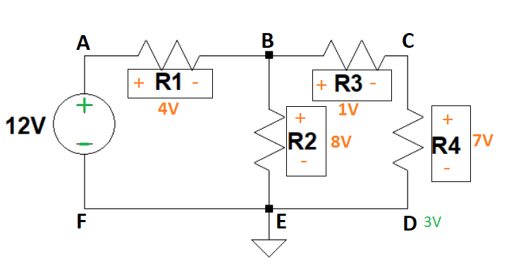
Different Labels for Voltage
TEST WHAT YOU LEARNED
Imagine that all the orange voltage numbers are still there but the green were removed If the voltage at point D was actually 3 volts instead of 0 and you were passing through resistor R4 that has a difference of 7volts to point C, what would the voltage at point C be?

Slide 25
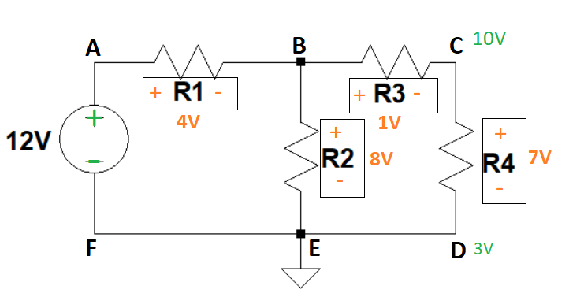
Different Labels for Voltage
ANSWER
It would be 10V
Since we are starting at 3 volts at point D and are going in the opposite direction of the current to point C, then we are looking at an increase of 7V
Note that the current will not pass in the direction of point D to point C. It will only go from the positive end of the battery to the negative, but sometimes our calculations have to be in the opposite direction of the current if we don’t know important information needed in an earlier part of the circuit.

Slide 26
Kirchhoff's Current Law

Slide 27
Kirchhoff's Current Law
You will typically see Kirchhoff’s Current Law noted like this:
ΣIin = ΣIout
Σ = summation or sum total
Please note, if you are viewing Kirchhoff’s current law from a math lense, it is actually the absolute value of the sums of in’s and sums of outs.
| ΣIin | = | ΣIout |
Kirchhoff’s current law states that the algebraic sum of all currents entering and exiting a node must be zero.
Here we are referencing a node specifically at the path of intersection.

Slide 28

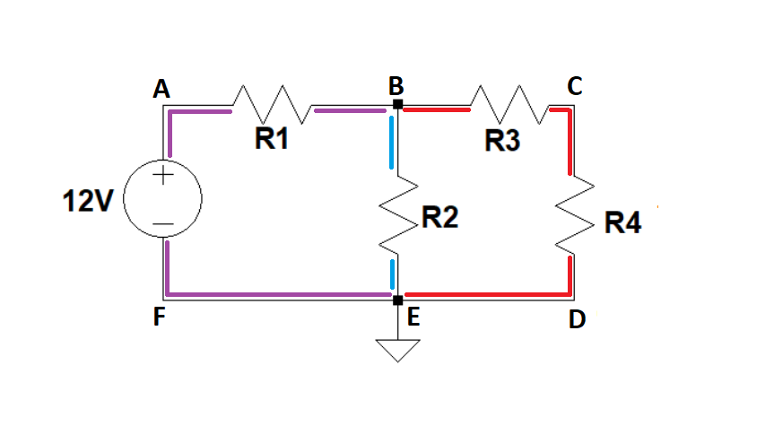
Kirchhoff's Current Law
We will use color theory now to explain current. As you most likely learned in school, red and blue paint can be mixed to make purple.
In the same way, the total current in a closed circuit will always have the same total, but it can be divided amongst different forking paths.

Slide 29
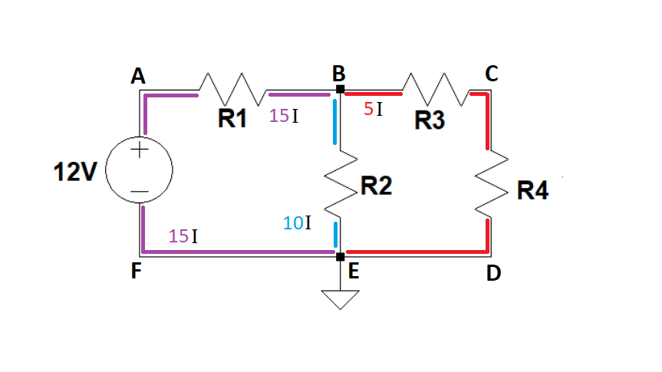
Kirchhoff's Current Law
Here we see that we start with 15 amps of current and it breaks off into two paths. One path has 5 amps of current and the other has 10 amps of current. Eventually they return to their sum total.

Slide 30
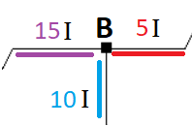
Kirchhoff's Current Law
We are going to close up to the part of the circuit we just looked at where the current went into different paths.
We will be using the +/- direction of the battery

Slide 31
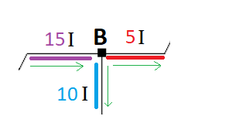
Kirchhoff's Current Law
The current always goes from the positive end of the battery to the negative. This means that in the circuit we were looking at, the current was passing from the 15I end into node B and forking off into the 5I path and the 10I path
For this reason, 15I will be the total (or summation) of I-ins and 5I and 10I together will be the total of the I-outs.
so 15I = 10I + 5I
meaning 15Iins = 15Iouts

Slide 32
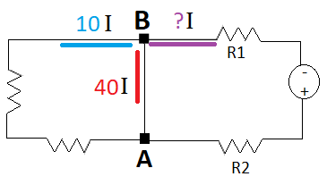
Kirchhoff's Current Law
TEST WHAT YOU LEARNED:
QUESTION 1
Which would count as ins and which would count as outs for node B?
HINT: look at the battery to figure out the direction of the current.

Slide 33
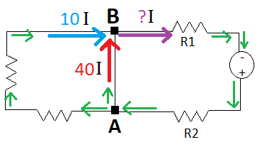
Kirchhoff's Current Law
ANSWER:
QUESTION 1
Since the lower part of the battery is the +, that means that the current would first pass through resistor R2, to get to node B.
This means that for node B, the red 40 amps and blue 10 amps are the I-ins and the unknown purple amps are the I-outs.

Slide 34
Kirchhoff's Current Law
TEST WHAT YOU LEARNED:
QUESTION 2
Now that we know that the 40I and 10I are the I-ins and the unknown purple I is the I-out, what is the amperage for the purple current?
Reminder: ΣIin = ΣIout

Slide 35
Kirchhoff's Current Law
ANSWER:
QUESTION 2
To get the answer we need to use ΣIin = ΣIout
That means 10I + 40I = ?I
So the purple portion of the current is then 50 amps or 50I

Slide 36
Kirchhoff's Voltage Law

Slide 37
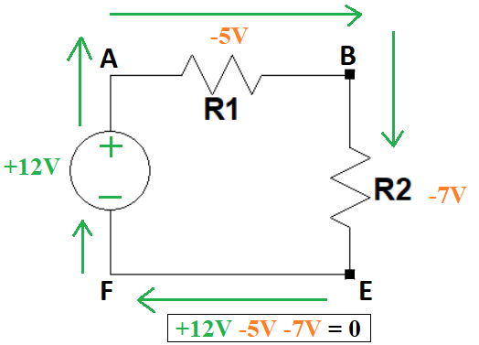
Kirchhoff's Voltage Law
Kirchhoff’s voltage law states that the sum of the voltage differences around any closed loop in a circuit must be zero.
In the example to the left, the 12 volts supplied by the battery is decreased by the two resistors until the voltage is 0. The last step of the path is crossing through the battery where it increases by 12 volts and starts over again.

Slide 38
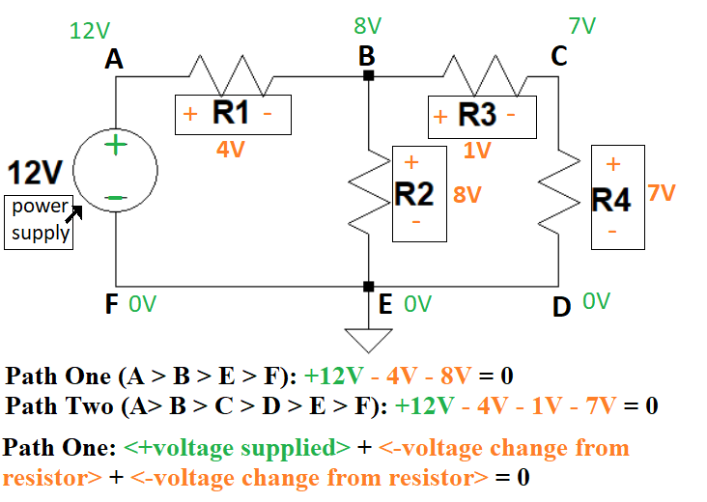
Kirchhoff's Voltage Law
Another way to think of Kirchhoff’s voltage law is that the voltage being supplied to a circuit by either one or multiple power sources, needs to equal the amount of voltage that is being stopped by resistors (or other circuit elements) on a single path.
In the same example we used in earlier slides, as you pass from the positive end of the battery through point A and eventually end back at the negative end of the battery, the voltage will be 0 by the end, until it passes through the battery again and returns to 12.

Slide 39
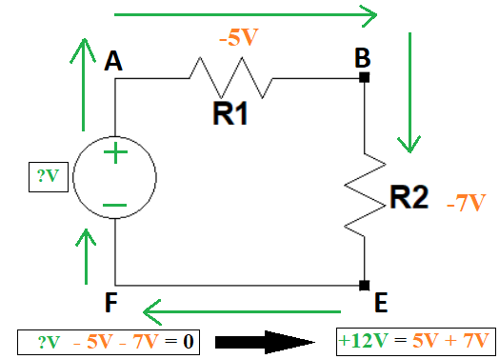
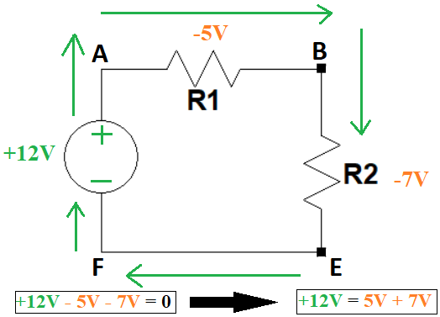
Kirchhoff's Voltage Law
If there was a voltage we didn’t know in a circuit. We could use Kirchhoff’s voltage law to find the value of that voltage.
In the example to the left, we see how the voltages can be moved from one side to another to isolate one unknown voltage.
The voltage supplied by the battery in this example is unknown, so we could move each decrease in voltage from each resistor to the other side to find out how much voltage the battery is producing.

Slide 40
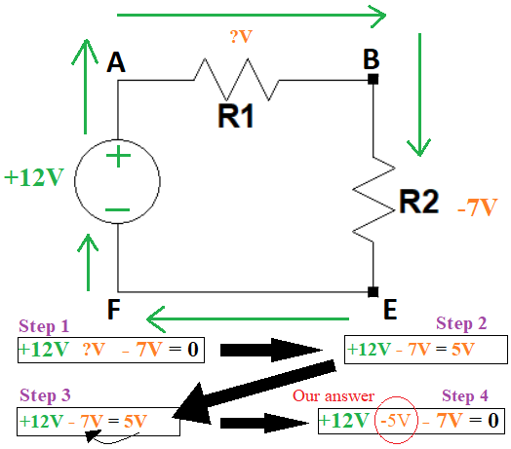
Kirchhoff's Voltage Law
Here is a second example. We know the voltage being supplied by the battery and the voltage reduced from resistor R2, but we don’t know the voltage reduced from R1.
Our first step would be to first write the equation with Kirchhoff’s voltage law.
Our second step would be to isolate the unknown voltage and solve for it.
Is our answer positive 5 or negative 5? Another way to approach this question is, is a resistor supplying voltage to a circuit (positive) or is it taking voltage away from a circuit (negative)?
It is taking voltage away from the circuit. We need to return it to the left of the equals sign where it originally came from in order to get the accurate answer.
This means that our final answer is R1 reduces the voltage by 5 volts or R1 = -5V.
Why didn’t we have to move the 12V in the prior example? Because we hadn’t moved it to the right side to isolate it, we moved the change in voltages from the resistors.

Slide 41
Bringing the Knowledge We Learned Together: Kirchoff’s Voltage and Current Law

Slide 42
Bringing Kirchoff’s Voltage and Current Law together to understand unknown parts of a current
We will be tested to calculate voltage, current, and resistance in different parts of a circuit. In order to do that, we will use Kirchoff’s voltage and current laws
Before we can start making calculations, we need to know the math for finding unknown voltage, current, and resistance.

Slide 43
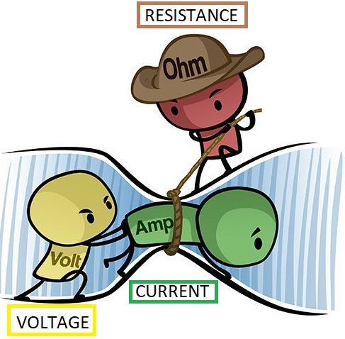
Voltage, Current, & Resistance Math
Remember that voltage is the force moving current (electrons) through a circuit. Resistance opposes some electrons from their path through the circuit which then reduces the voltage at the other end.

Slide 44
Voltage, Current, & Resistance Math
CALCULATIONS
Current = Voltage / Resistance
Amps = Volts/ Ohms
I = V/Ω
.Voltage = Current x Resistance
Volts = Amps x Ohms
V = I x Ω
Resistance = Voltage / Current
Ohms = Volts / Amps
Ω = V / I

Slide 45
Unknown Current
Sometimes we will calculate the total current through a circuit and other times we will calculate the current at a specific part of the circuit.
Let’s start with calculating unknown current at a specific spot

Slide 46
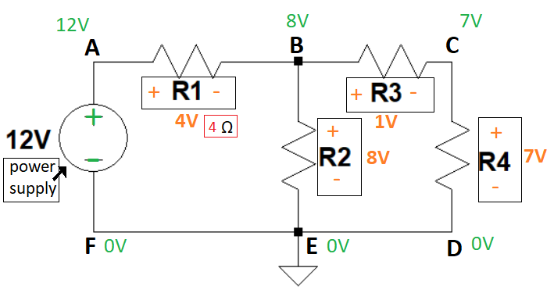
Unknown Current 1 - Question
We will be using the same example we have seen in earlier slides
Let’s say that R1 has 4Ω of resistance. How do we calculate the current going through R1?
Do we use 12V or 4V to solve for current through R1?

Slide 47
Unknown Current 1 - Answer
If we only have the resistance for R1 and want to know the current going through it, we need to use the difference of current for R1 in our equation
Current = Voltage / Resistance
I =4V/4Ω
So I at R1 = 1 amp

Slide 48
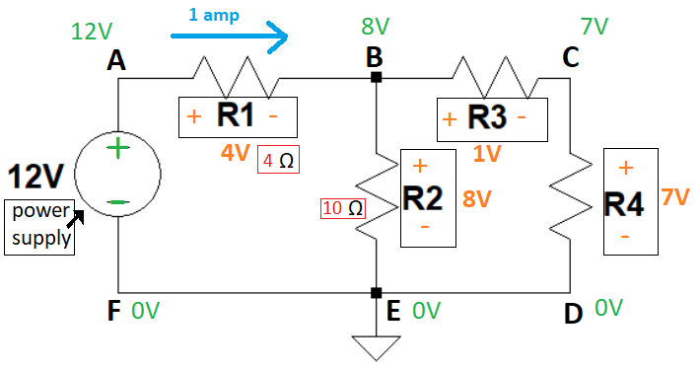
Unknown Current 2 - Question
Now lets say resistor R2 has 10Ω of resistance.
How much current would be going through R2?

Slide 49
Unknown Current 2 - Answer
We would again be using [current = voltage / resistance] or I = V/Ω
So I = 8V/10Ω
This means that the current that forked off from node B through R2 = .8 amps

Slide 50
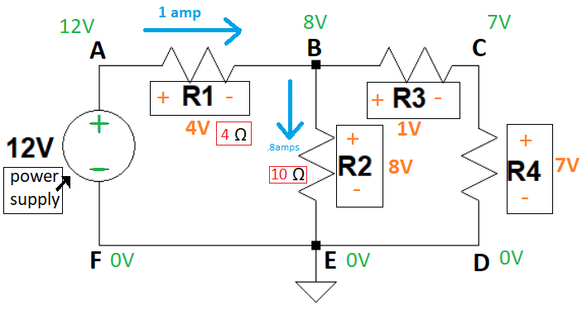
Unknown Current 3 - Question
With the information we have, we can figure out the resistance for R4.
Try to see if you can figure it out.
Hint: Resistors R3 and R4 have the same current going through them.

Slide 51
Unknown Current 3 - Answer
As we know from Kirchoff’s current law, the I-ins need to equal the I-outs or ΣIin = ΣIout
Since the current is going from node A to node B and then forking off to either node C or E, we know that the 1amp is the Iin for node B and the .8 amps is the Iout for point B. Lastly, the unknown amperage going to point C would also be an out because of the path of the current.
So 1amp =.8amps + ?amps
or 1amp -.8amps = ?amps
So R3 & R4 both have .2I of current going through them
There is no place between resistors R3 and R4 where the current can fork off, so that means that they have the same current going through them

Slide 52
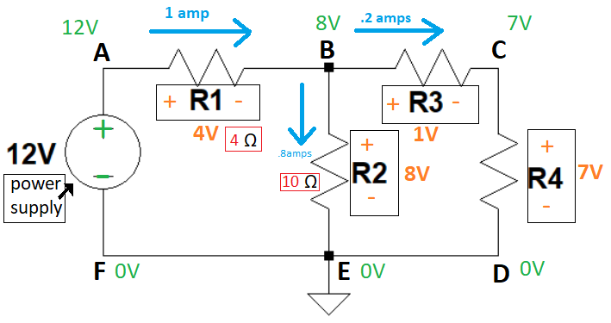
Unknown Current 3 - Answer 2
Again, we know that R3 & R4 have the same current going through them, because there are no other places where the current forks off between the two resistors.
For R4, we know that it results in a difference of 7V of voltage and has .2I of current. We just need to use our equation to find out the resistance.
Ω = V / I
R4Ω = 7V / .2I
The resistance of R4 is then 35 ohms
If we wanted to find out the resistance for R3, we would use the same equation but with 1V (R3Ω = 1V / .2I)

Slide 53
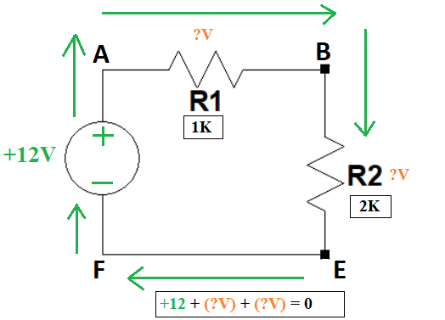
Unknown Current 4: Combining Kirchhoff’s Voltage Law & V=I*R
Let’s say that we have two unknowns. We want to find out the current (one unknown) but we also don’t know the voltage decrease of our resistors (second unknown). How would we solve this?
We are going to combine Kirchoff’s Voltage Law and Voltage = Current * Resistance
We start with +12V + (-V) + (-V) = 0
Calculations for resistor R1
V = I * R
V = I * 1000Ω (note that the 1K stands for 1,000Ω of resistance for R1)
This means that we can plug I * 1000Ω for the first V
Updated equation: +12V + (-(I*1000Ω)) + (-V) = 0
Now we just have one more resistor to calculate, R2
V = I * R
V = I * 2000Ω
This means that we can plug in I * 2000Ω for the second V
Updated equation: +12V + (-(I*1000Ω)) + (-(I*2000Ω)) = 0
Now that we only have one unknown, the current that we are trying to find, we can do the math to isolate I:
+12V + (-(I*1000Ω)) + (-(I*2000Ω)) = 0 (move 12V over first)
(-(I*1000Ω)) + (-(I*2000Ω)) = -12V (next add I’s*Ω’s)
(-(I*3000Ω)) = -12V (divide by Ω to isolate the current (I))
(I) = -12V / -3000Ω
Our solution to the current is then I = 0.004 amps

Slide 54
Positive and Negative Values

Slide 55
Positive & Negative Values
Remember our solution to the the problem on the last slide was that the current was 0.004 amps
Please note that it will be easy to not move negative signs correctly. There are some things we can instantly check to see if our answer is correct.
The green voltage represents voltage supplied to a circuit from a circuit element and voltage present later in the circuit. The circuit elements, like batteries, that provide voltage should always be positive. The green voltage through the circuit would only go as low as 0 in a closed circuit.
The orange voltage represents a change in voltage. If you are going in the direction of current, like from node A to B for resistor R1, and are crossing a resistor, the resistor would be removing voltage so the voltage would be negative.
If your calculations are going in the opposite direction of the current, like from node B to A, and are crossing a resistor, like R1, the orange voltage (or change in voltage) should be positive because we are going in the opposite direction of how the current or electrons actually flow. We are looking at the opposite of how the circuit element, the resistor, would normally function.

Slide 56
Reminder: Positive & Negative Values
With what we know about current, would current ever be negative?
A reminder that current is the flow of electrons through a circuit.
Can we have negative electrons?

Slide 57
Reminder: Positive & Negative Values
No we cannot have negative electrons.
We cannot have negative matter, so current would always be positive.

Slide 58
Combining Kirchhoff’s Voltage Law & V=I*R Revisited

Slide 59
Combining Kirchhoff’s Voltage Law & V=I*R Revisited
A few slides ago, we calculated the current of the circuit in the lower left corner of this slide by combining:
Kirchhoff’s Voltage Law
(voltage supplied) + (voltage removed) = 0
And the equation V = I * R
(voltage = current * resistance)
Would we be able to do this if the current split off into different sections of a circuit, like the circuit in the lower right of this slide?

Slide 60
Combining Kirchhoff’s Voltage Law & V=I*R _ Revisited
In order to be able to combine Kirchhoff’s Voltage Law and V = I * R, we would have to have both equations work.
Let’s test Kirchhoff’s Voltage law on the full circuit to see if it works.
+12V - 4V - 8V - 1V - 7V = ? (needs to equal 0 for Kirchhoff’s voltage law
The equation above equals -8 so this doesn’t work
Let’s try instead using a single path
+12V - 4V - 8V = ?
This equals zero so that works
That did work, so we would have to make sure that V = I * R will work
In this scenario, calculating the current going through the full circuit cannot be done by choosing a singl path. Why?
What did we learn about Kirchhoff’s Current Law?
At node B the current is forking off so the current going through resistor R2 and the current going through R3 and R4 is not the same. This makes use of the tactic of combining Kirchhoff’s Voltage Law and V = I * R not work. It doesn’t work because the resistors are not in series.

Slide 61
In Series and Parallel Circuit Elements

Slide 62
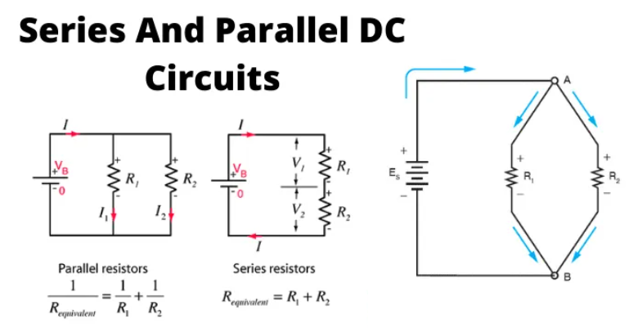
IN SERIES VS PARALLEL
In a series circuit, every device must function for the circuit to be complete. If one bulb burns out in a series circuit, the entire circuit is broken. In parallel circuits, each light bulb has its own circuit, so all but one light could be burned out, and the last one will still function.
SERIES
Components connected in series are connected along a single "electrical path", and each component has the same current through it, equal to the current through the network. The voltage across the network is equal to the sum of the voltages across each component.

Slide 63
SERIES VS PARALLEL
(the info in this grey box did not change from the last slide)
In a series circuit, every device must function for the circuit to be complete. If one bulb burns out in a series circuit, the entire circuit is broken. In parallel circuits, each light bulb has its own circuit, so all but one light could be burned out, and the last one will still function.
PARALLEL
Components connected in parallel are connected along multiple paths, and each component has the same voltage across it, equal to the voltage across the network. The current through the network is equal to the sum of the currents through each component.

Slide 64
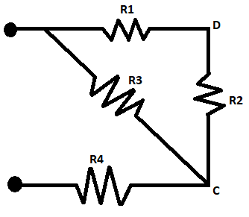
In Series vs Not In Series Resistors (1)
When two circuit elements (in this case we have resistors) are in series, it means they have the same current going through them.
Remember that current can fork off into different paths.
With the two points of info above, which two resistors in this example are in series?

Slide 65
In Series vs Not In Series Resistors (2)
Resistor R1 and R2 are in series. How can we tell?

Slide 66
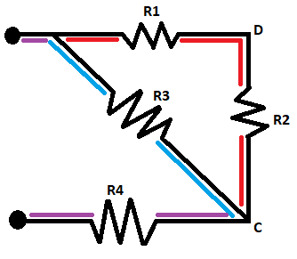
In Series vs Not In Series Resistors (3)
The path of the current forks off in two locations at the top and then rejoins together at node C.
So R1 and R2 are the only resistors that don’t have a location where the current could change in between them.
If you are confused, you may be confusing where current can change in a circuit versus where voltage can change in a circuit.

Slide 67
Where Current Can Change vs Where Voltage Can Change In a Circuit

Slide 68
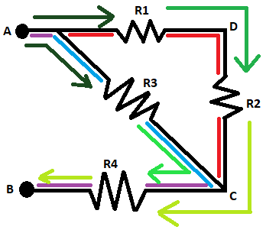
Where Current Changes vs Where Voltage Changes
The path of the current forks off in two locations at the top and then rejoins together at node C. This is depicted by the purple, blue, and red lines.
The path of the voltage goes from the positive end of the power source to the negative end (from point A to point B in this case). This is depicted by the green arrows that are getting lighter and lighter.
The voltage decreases at each resistor.
The current changes when there are 2 or more paths it forks off to.

Slide 69
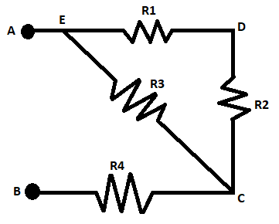
Where Current Changes vs Where Voltage Changes Test Your Knowledge
Let’s test what we learned in the last slide. At what locations on this circuit could the voltage change and at what locations could the current change?

Slide 70
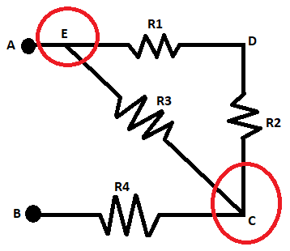
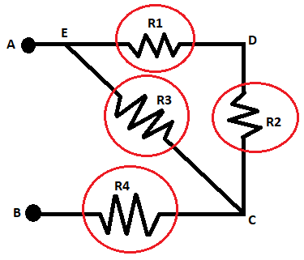
Where Current Changes vs Where Voltage Changes Test Your Knowledge
The picture below shows where the current can change in the circuit (at the forking paths).
The picture below shows where the voltage can change in the circuit (at the resistors).

Slide 71
Equivalent and Effective Resistance

Slide 72
Equivalent and Effective Resistance
Equivalent resistance is a purely resistive property, which does not change with any other variable. Effective resistance is another name given to the impedance. Impedance is a property, which changes with the frequency of the signal.
Impedance is a property, which changes with the frequency of the signal. Equivalent resistance is defined to a set of resistors or components having resistance only.
The effective resistance can be defined to each component of a circuit.
We will be dealing with equivalent resistance

Slide 73
Calculations of Equivalent Resistance of Circuit Elements in Series vs Parallel Circuit Elements

Slide 74
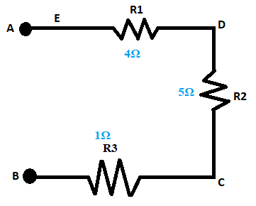
Equivalent Resistance of Resistors in Series (1)
When resistors are in series, we can calculate the equivalent resistance (or Req) through simple addition
If we know the resistance for R1, R2, and R3 we can calculate the Req for the entire circuit
In this example, Req is 4Ω + 5Ω + 1Ω
So the Req for the full circuit is 10Ω

Slide 75
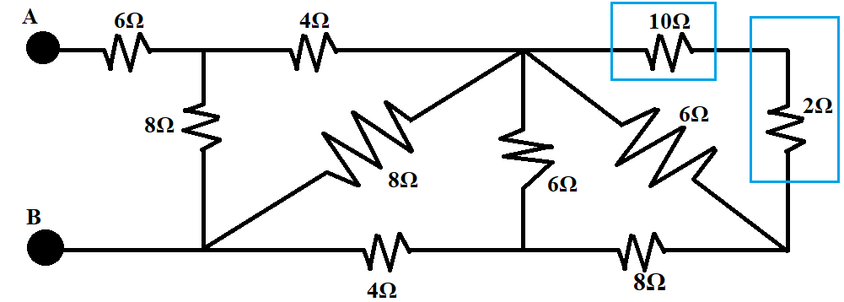
Equivalent Resistance of Resistors in Series (2)
Below is another example of two resistors in series
The 10Ω and 2Ω resistors are in series because there is no location between them where the path, or current, can fork off
Since we know we can calculate the Req of resistors in series through simple addition, we can just add them
So Req of the 10Ω and 2Ω resistors is 10Ω + 2Ω
Req of those two resistors is 12Ω

Slide 76
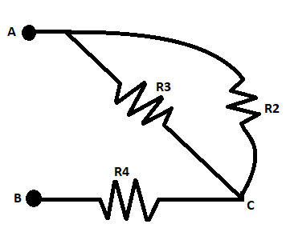
Equivalent Resistance of Parallel Resistors (1)
If two or more components are connected in parallel, they have the same difference of potential (voltage) across their ends. The potential differences across the components are the same in magnitude, and they also have identical polarities. The same voltage is applied to all circuit components connected in parallel. The total current is the sum of the currents through the individual components, in accordance with Kirchhoff's current law.
In this example, R2 and R3 are parallel. Each end connects back to the other resistor

Slide 77
Equivalent Resistance of Parallel Resistors (2)
As we said, in this example, R3 and R2 are parallel
To calculate the Req of the two parallel resistors, we use the following equation:
(R2 * R3) / (R2 + R3)

Slide 78
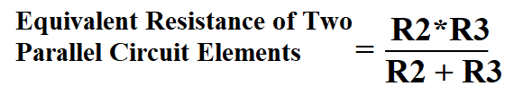
Equivalent Resistance of Parallel Resistors
Question 1
If R3 has 8Ω of resistance and R2 has 8Ω of resistance, what is the Req of R3 and R4?

Slide 79
Equivalent Resistance of Parallel Resistors
Answer 1
If R3 and R2 are both 8Ω, then your math should have looked like this:
(8*8)/(8+8) = 4Ω

Slide 80
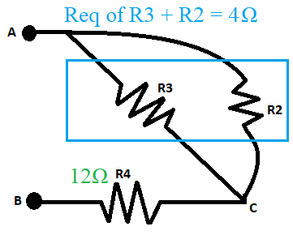
Equivalent Resistance of Parallel Resistors
Question 2
If Req of [R3 and R2] is 4Ω and R4’s resistance is 12Ω, then what is the Req of the total circuit?
Do we add 4Ω and 12Ω or should we be using the equation above?

Slide 81
Equivalent Resistance of Parallel Resistors
Question 2 Strategy
To figure out if we need to add 4Ω or use the equation above, we need to decide if the Req of R3 and R2 is in series with R4 or if it is parallel with R4.
When first learning these problems, it can be easiest to redraw the portion of the circuit you figured out to determine if it is in series with or parallel with the next element.

Slide 82
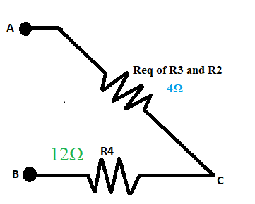
Equivalent Resistance of Parallel Resistors
Question 2 Answer
Here we redrew resistors R3 and R2 as one resistor
This makes it much easier to see that the Req of R3 and R2 is in series with R4 so to get the Req of the full circuit, we would just need to add the 4Ω with the resistance of R4 (12Ω) to get Req of the full circuit.
This means that Req of the full circuit = 12Ω + 4Ω or 16Ω

Slide 83
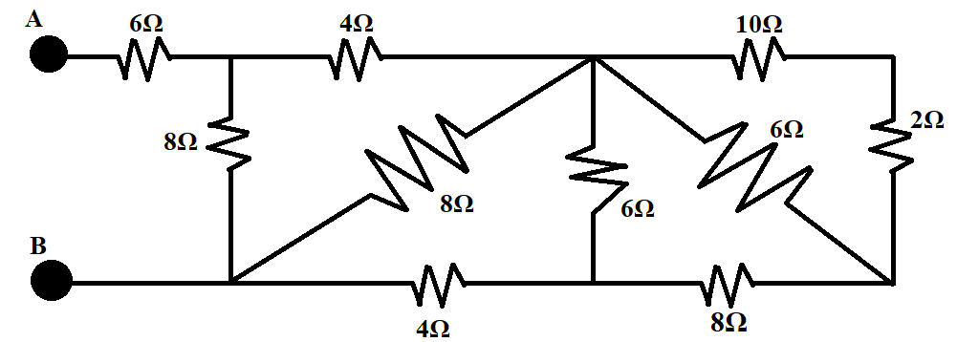
Why calculate the Req of parallel resistors and resistors in series?
We calculate the Req of parallel resistors and resistors in series through a circuit so that we can find out the Req of the full circuit
There will be times that we need to make equations of the full circuit, like when we have sufficient information to find out the current going through the full circuit as long as we know the resistance of the full circuit

Slide 84
Calculating the Equivalent Resistance of a Full Circuit with Parallel Circuit Elements and Circuit Elements in Series

Slide 85
Finding the Equivalent Resistance of a Full Circuit with Parallel and in Series Circuit Elements
We are now going to put everything together that we leared to find out the Req (or equivalent resistance) of the full circuit below.
This is the same circuit we saw in an earlier slide and we already determined that the rightmost corner had two resistors in series so the Req of those two resistors would be the sum of the two or 10Ω + 2Ω, which is 12Ω.

Slide 86
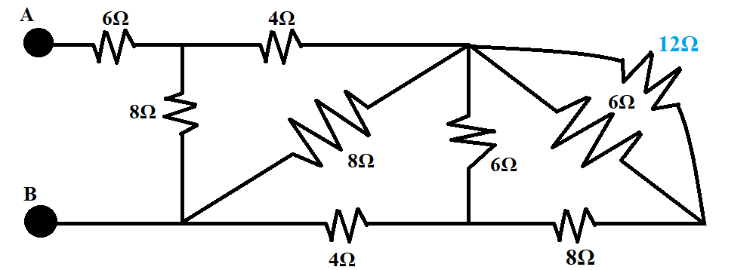
Finding the Equivalent Resistance of a Full Circuit with Parallel and in Series Circuit Elements
Now that we figured out the12Ω, we want to see how that compares with the 6Ω. Do we calculate the Req of the two different resistance values through addition or through the equation we learned?
Another way to word the question: Are the two values in series or parallel?

Slide 87
Finding the Equivalent Resistance of a Full Circuit with Parallel and in Series Circuit Elements
The12Ω and 6Ω resistance values are parallel so we need to use our equation.
That means we would take [(12Ω * 6Ω) / (12Ω + 6Ω)]
So the Req of the two values would be (72Ω/18Ω)
This means that the Req of the two values would be 4Ω

Slide 88
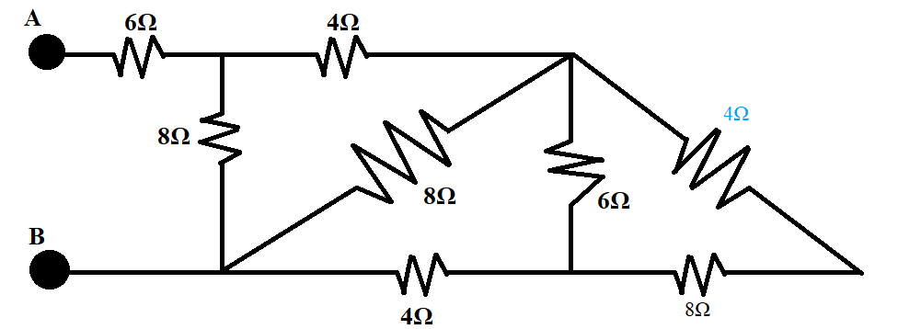
Finding the Equivalent Resistance of a Full Circuit with Parallel and in Series Circuit Elements
Which resistors would we be tackling next? The 6Ω and 4Ω resistors, the 4Ω and 8Ω, or all three?
We would tackle the 4Ω and 8Ω resistors next.
Are these in series or are they parallel? Again, is there a place in between the 4Ω and 8Ω resistors where the current could fork off to different paths? There is not. So these are in series.
This means that we can just add them up so the Req of the two resistors would be 4Ω + 8Ω
The Req of the two resistance values would then be12Ω

Slide 89
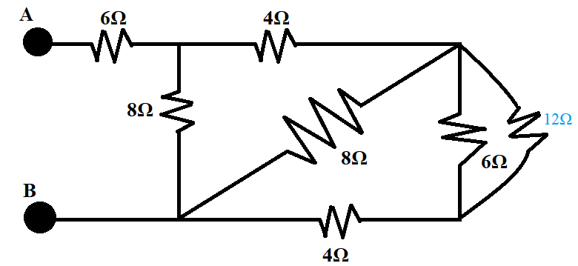
Finding the Equivalent Resistance of a Full Circuit with Parallel and in Series Circuit Elements
We will next deal with the 6Ω and 12Ω resistors. We need to first decide if they are in series or parallel a.k.a. we need to decide if there is a place where the current can fork off and result in a different current between the two.
They are parallel. Since they are parallel, we will then be using the equation in the lower right corner of this powerpoint slide to figure out the Req of the two values.
The math would be set up like this:
[(6Ω * 12Ω)/(6Ω + 12Ω)]
[72Ω/18Ω]
So the Req = 4Ω

Slide 90
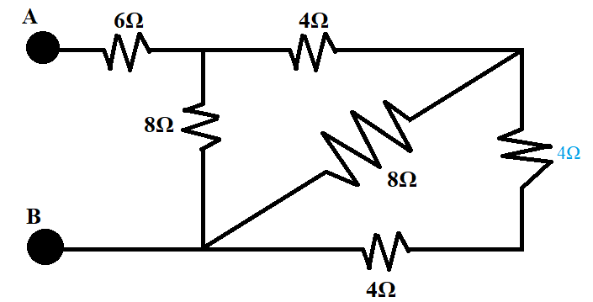
Finding the Equivalent Resistance of a Full Circuit with Parallel and in Series Circuit Elements
What will be the next two resistance values that we will work with?
The 4Ω and the 4Ω resistance values
Are they in series or are they parallel?
There is no place between the two resistors where the current can fork off so they are in series.
Since they are in series, we would figure out the Req of the two values by just adding them together so the Req of the two resistors would be 4Ω + 4Ω
This means that the Req = 8Ω

Slide 91
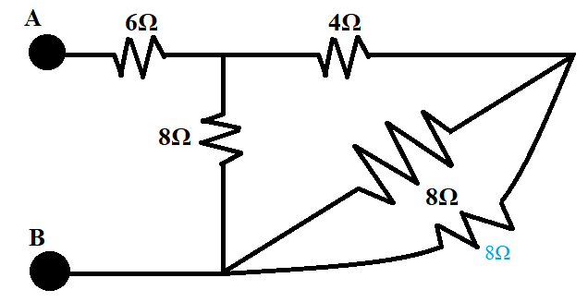
Finding the Equivalent Resistance of a Full Circuit with Parallel and in Series Circuit Elements
We will now be handling the 8Ω and the 8Ω resistance values.
Just like the other sections of the circuit, the first thing we need to figure out is if they are parallel or in series. Is there a place where the current can fork off in between the two resistance values? There are places where the current can fork off so they are parallel. This means we need the equation below to calculate the Req of the two resistance values.
The math would be set up like this:
[(8Ω * 8Ω)/(8Ω + 8Ω)]
[(64)/(16)]
Req of the two resistance values is then 4Ω

Slide 92
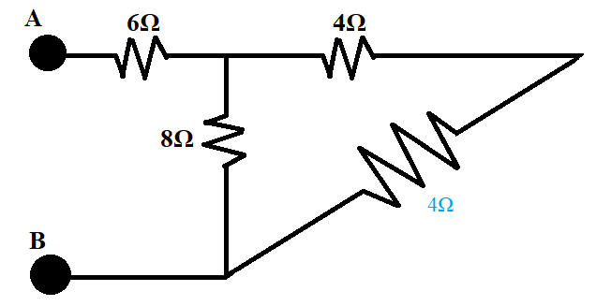
Finding the Equivalent Resistance of a Full Circuit with Parallel and in Series Circuit Elements
We will now be handling the 4Ω and the 4Ω resistance values.
Again, the first thing we need to figure out is if they are parallel or in series. Is there a place where the current can fork off in between the two resistors? There is not so they are in series.
Since they are in series, we can just add the values to get the Req.
The math would be set up like this:
[(4Ω+ 4Ω)]
Req of the two resistance values is then 8Ω

Slide 93
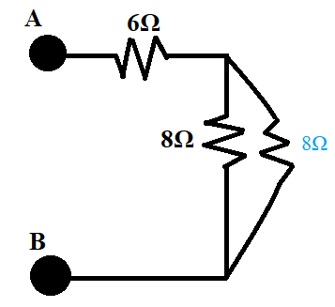
Finding the Equivalent Resistance of a Full Circuit with Parallel and in Series Circuit Elements
We will now be handling the 8Ω and the 8Ω resistance values.
Again, the first thing we need to figure out is if they are parallel or in series. Is there a place where the current can fork off in between the two resistors? There is, so they are parallel. This means we need the equation at the bottom of this slide to figure out the Req of the two values.
The math would be set up like this:
[(8Ω * 8Ω)/(8Ω + 8Ω)]
[(64)/(16)]
Req of the two resistance values is then 4Ω

Slide 94

Finding the Equivalent Resistance of a Full Circuit with Parallel and in Series Circuit Elements
Lastly, we will be handling the 6Ω and the 4Ω resistance values.
The first thing we need to figure out is if they are parallel or in series. Is there a place where the current can fork off in between the two resistors? There is not so they are in series. This means we can add them together.
The math would be set up like this:
6Ω + 4Ω = Req
Req of the two resistance values is then 10Ω
There are no other resistors so the Req of the full circuit is 10Ω

Slide 95
Voltage Division & Current Division

Slide 96
Current Division Possible if resistors are parallel Voltage Division Possible if resistors are in series
How to remember? They match up in alphabetical order.
C comes before V just like P comes before S

Slide 97


Voltage Division
The goal of voltage division is to determine the change in voltage across a resistor
Voltage division can be done if...
The two resistors involved in the calculations are in series
The voltage accross the resistors is known

Slide 98

Voltage Division Example
In this example, we want to find how much the voltage decreases after passing through resistor R1.
Notice on this circuit diagram that 1K and 2K stand for 1,000 Ω of resistance and 2,000 Ω of resistance.
Since the resistors are in series and the voltage of the power source is known, we can do voltage division.
The math is laid out below the image of the resistor.

Slide 99


Current Division
The goal of current division is to calculate the current flowing through a resistor
Current division can be done if...
The two resistors involved in the calculations are parallel
The voltage accross the resistors is known

Slide 100

Current Division Example
In this example, we are trying to find the current running through R1. Remember that in voltage division the same resistor that we wanted the voltage for was in the numerator by itself? In current division it is the opposite. Besides that, and the power sources current being swapped for the power sources voltage, current division is almost the same equation as voltage division.
As seen above, we can do voltage division on R1 and R2 because they are parallel.
We take the voltage of the opposite resistor we are calculating for, divide it by the sum of the two resistors, and then multiply that by the current of the power source, or the total current.

Slide 101
Time Constant Tau

Slide 102
RC Time Constant - Tau
Tau or the RC time constant is the time required to charge the capacitor, through the resistor, from an initial charge voltage of zero to approximately 63.2% of the value of an applied DC voltage, or to discharge the capacitor through the same resistor to approximately 36.8% of its initial charge voltage
Time Constant of a Capacitor
Time = Resistance*Capacitance
Seconds = Ohms*Farads
t (tau) = R*C

Slide 103
RL Time Constant - Tau
Tau or the RL time constant indicates the amount of time that it takes to conduct 63.2% of the current that results from a voltage applied across an inductor. The value 63.2% derives from the calculus equations used to determine the exact time constants for both resistor-capacitor and resistor-inductor networks.
Time Constant of an Inductor
Time = Inductance / Resistance
Seconds = Henrys / Ohms
t (tau) = L/R

Slide 104
Linearity

Slide 105
Linearity
If two things together added up, then they have a linear relationship
System has to be linear for distance 1 and distance 2 to equal the total distance
Dtotal = d1 + d2

Slide 106
Thevenin Voltage and Thevenin Current

Slide 107
Thevenin Voltage and Thevenin Current
Thevenin's Theorem states that “Any linear circuit containing several voltages and resistances can be replaced by just one single voltage in series with a single resistance connected across the load.”
The point of using Thevenin’s Theorem is to find the voltage and current at one point in a circuit
So far in our past examples, they each had one single power source (and/or current source). Using thevenin’s voltage and current help us understand the current and voltage at a certain point in a circuit when there are multiple power (and/or current) sources in the entire circuit.

Slide 108
Thevenin’s Theorem (make circuit below of basic thevenin circuit)
As we said before, Thevenin's Theorem states that “Any linear circuit containing several voltages and resistances can be replaced by just one single voltage in series with a single resistance connected across the load.” So any circuit can be represented with a single voltage source (V-thevenin), a single resistor (R-thevenin), and a load resistor (RL) or the resistor that we are making calculations on

Slide 109

Thevenin’s Theorem
We are going to use the circuit above to show how to use Thevenin’s Theorem.
We want to find V-thevenin, or the voltage potential between points A and B.
Remember that voltage on a circuit diagram can either be the voltage present at a certain point (represented in green), or the change in voltage from a circuit element, like a resistor (represented in orange). V-thevenin would be the change in voltage, or the type of voltage represented in orange in past diagrams.

Slide 110
Index / Resources

Slide 111
Units of Measurement

Slide 112
Resistance
SI unit for resistance: ohms
Symbol: Ω
Electrical resistance is the measure of a circuit element’s opposition to the flow of electric current. It is usually measuring how much something interrupts the flow of electrons.
Because of resistance, voltage will lower after passing through a circuit element like a resistor

Slide 113
Current
SI unit for current: amps
Symbol: I
Current is the rate of flow of electric charge or movement of charges.
It usually is measuring the flow of electrons through a circuit.
Current always goes from the positive end of the power source through the circuit until it reaches the negative end of the power source and goes through the loop again.
Normally the current would be electrons aimlessly moving around, but they are given a direction of flow from the push from voltage

Slide 114
Voltage
SI unit for voltage: volts
Symbol: V
Voltage is a measure of how much pressure is applied to a current (or how much pressure is applied to charged electrons).
Voltage can also be described as the potential difference in electrical energy between two points in an electrical field or circuit.
NOTE:
Sometimes the number of volts on the diagram will show the voltage present at that location in the circuit
Other times, the number of volts will represent the difference between two locations, but that will be discussed later

Slide 115
Charge
SI Unit: Columb
Symbol: q
Charge = Current * Time
columbs = amps * seconds
q = I * t
Charge is the physical property of matter that causes it to experience a force when placed in an electromagnetic field. Electric charge can be positive or negative (commonly carried by protons and electrons respectively).

Slide 116
Power
SI Unit: Watts
Symbol: W (sometimes p)
Power = Voltage x Current
Watts = Volts x Amps
W = V x I
Power is the rate at which work (or a unit of energy) is done or the amount of energy transferred or converted per unit time.

Slide 117
Energy
SI Unit: Joules
Symbol: J or E
Electrical Energy = Power x Time
Joules = Watts x Seconds
J = W x s
Energy is the capacity to do work.

Slide 118
Capacitance
SI Unit: Farads
Symbol: C
Capacitance = Charge/Voltage
Farads = Columbs/Volts
C = Q/V
Capacitance is the ability of a body to store electric charge
A capacitor is a passive linear component, which stores electrical energy.

Slide 119
Inductance
SI Unit: Henrys
Symbol: H or L
Time = Inductance / Resistance
Seconds = Henrys / Ohms
t = L / R
Inductance is the property of an inductor by which a change in current flowing through it “induces” (creates) a voltage (electromotive force) in both the inductor itself (self-inductance), and in any nearby inductors (mutual inductance).
When the current flowing through an inductor changes, it creates a time-varying magnetic field inside the coil, and a voltage is induced.

Slide 120
Energy Stored in a Capacitor
Energy Stored in a Capacitor = Charge * Change in Voltage
Joules = Columbs* Change in Volts
U = (Q)*(ΔV)
Energy Stored in a Capacitor = (1/2)*[(Charge^2)/Capacitance]
Joules = (1/2)*[(Columbs^2)/Farads
U = (1/2)*[(Q^2)/C]
Energy Stored in a Capacitor = (1/2)*[Capacitance*(Change in Voltage^2)]
Joules = (1/2)*[Farads* (Change in Volts^2)]
U = (1/2)*[C*(ΔV^2)]
SI Unit: Joules
Symbol: U
Capacitance is the ability of a body to store electric charge
A capacitor is a passive linear component, which stores electrical energy.

Slide 121
Derivations

Slide 122
Derivations
POWER
Power = Voltage x Current
Watts = Volts x Amps
W = V x I
Power = [ (Voltage)^2 ] ÷ Resistance
Watts = [ (Volts)^2 ] ÷ Ohms
W = V^2 ÷ Ω
Power = (Current)^2 x Resistance
Watts = (Amps)^2 x Ohms
W = I^2 x Ω
ENERGY
Electrical Energy = Power x Time
Joules = Watts x Seconds
J = W x s
Electrical Energy = Voltage x Current x Time
Joules = Volts x Amps x Seconds
J = V x I x s
Electrical Energy = [ (Voltage)^2 ] ÷ Resistance x Time
Joules = {[ (Volts)^2 ] ÷ Ohms} x Seconds
J = (V^2 ÷ Ω) x s
Electrical Energy = (Current)^2 x Resistance x Time
Joules = (Amps)^2 x Ohms x Seconds
J = I^2 x Ω x s
CURRENT
Current = Voltage / Resistance
Amps = Volts/ Ohms
I = V/Ω
Current = √(Power/ Resistance)
Amps = √(Watts/Ohms)
I = √(W/Ω)
Current = Power / Voltage
Amps = Watts/Volts
I = W/V
RESISTANCE
Resistance = Voltage / Current
Ohms = Volts / Amps
Ω = V / I
Resistance = Power / (Current^2)
Ohms = Watts / (Amps^2)
Ω = W / (I^2)
Resistance = (Voltage^2) / Power
Ohms = (Volts^2) / Watts
Ω = V^2 / W
ENERGY STORED IN A CAPACITOR
Energy Stored in a Capacitor = Charge * Change in Voltage
Joules = Columbs* Change in Volts
U = (Q)*(ΔV)
Energy Stored in a Capacitor = (1/2)*[(Charge^2)/Capacitance]
Joules = (1/2)*[(Columbs^2)/Farads
U = (1/2)*[(Q^2)/C]
Energy Stored in a Capacitor = (1/2)*[Capacitance*(Change in Voltage^2)]
Joules = (1/2)*[Farads* (Change in Volts^2)]
U = (1/2)*[C*(ΔV^2)]
VOLTAGE
Voltage = Current x Resistance
Volts = Amps x Ohms
V = I x Ω
Voltage = Power / Current
Volts = Watts / Amps
V = W / I
Voltage = √(Power x Resistance)
Volts = √(Watts / Ohms)
V = √(W x Ω)
CAPACITANCE
Capacitance = Charge/Voltage
Farads = Columbs/Volts
C = Q/V
CHARGE
Charge = Current * Time
columbs = amps * seconds
q = I * t

Slide 123
Derivations
INDUCTANCE THROUGH
AN INDUCTOR
[2π(Frequency)] = [1/ √(Inductance*Capacitance)]
[2π(Hertz)] = [1/ √(Henrys*Farads)]
[ 2πf ] = [1 / √(LC)]
CURRENT PASSING THROUGH AN INDUCTOR
Voltage = inductance of inductor * (current of inductor / seconds from inductor)
Volts = Henrys * (amps / seconds)
V = L*(di / dt)

Slide 124


Ohms Law Formulas

Slide 125

Measurement Conversion Chart

Slide 126
Circuit Diagram Schematic Symbols

Slide 127

Capacitor Schematic Symbols

Slide 128

Electrical Grounding Schematic Symbols

Slide 129

Inductor and Coil Schematic Symbols

Slide 130

Power Source Schematic Symbols

Slide 131

Resistor Schematic Symbols

Slide 132
Lab Equipment

Slide 133

DC Power Supply
Model: Elenco DC Power Supply XP-770

Slide 134
DC Power Supply
Model: Elenco DC Power Supply XP-770
DC power supply is only a voltage source
Direct current (DC) power, as you may suss from the name, is a linear electrical current—it moves in a straight line. ... DC power is far more consistent in terms of voltage delivery, meaning that most electronics rely on it and use DC power sources such as batteries.

Slide 135

Oscilloscope
Model: Agilent Technologies InfiniiVision DSO7012B

Slide 136
Oscilloscope
Model: Agilent Technologies InfiniiVision DSO7012B
Oscilloscope
An oscilloscope is a type of electronic test instrument that graphically displays varying signal voltages, usually as a calibrated two-dimensional plot of one or more signals as a function of time.
X and Y axis
Hortizontal (x-axis) is time in seconds
Vertical (y-axis) is voltage

Slide 137

Signal Generator
Agilent 33220A 20MHz
Function/Arbitrary Waveform Generator

Slide 138
Signal Generator
Agilent 33220A 20MHz Function/Arbitrary Waveform Generator
Signal Generator
A signal generator is one of a class of electronic devices that generates electronic signals with set properties of amplitude, frequency, and wave shape.

Slide 139

Multimeter
Agilent 34401A 6.5 Digit Multimeter

Slide 140
Multimeter
Agilent 34401A 6.5 Digit Multimeter
Multimeter
A multimeter is a measuring instrument that can measure multiple electrical properties. A typical multimeter can measure voltage, resistance, and current, in which case it is also known as a volt-ohm-milliammeter, as the unit is equipped with voltmeter, ammeter, and ohmmeter functionality.

